Slide 2
Ruggardise the RAM and controller … consolidate Arduino to VTC
Up spec the VTC (16GB or 32GB)
Make Antenna assembly an ALL-IN-ONE (reduce cabling and infrastructure complexity)
Find a way to perform tailings material lab tests on site (easy to perform process)
Coordinate with UQ
What apparatus is required?
Find a way to add the SITE analysis to the Antenna interface as a calibration option
Add a value in a dialogue box?
Interface to add Site and Value
Integrate the MoteC Log File (GPS Lat / Long) with the VNA Log file
Add GPS to VTC … this removes need to integrate files

Slide 3
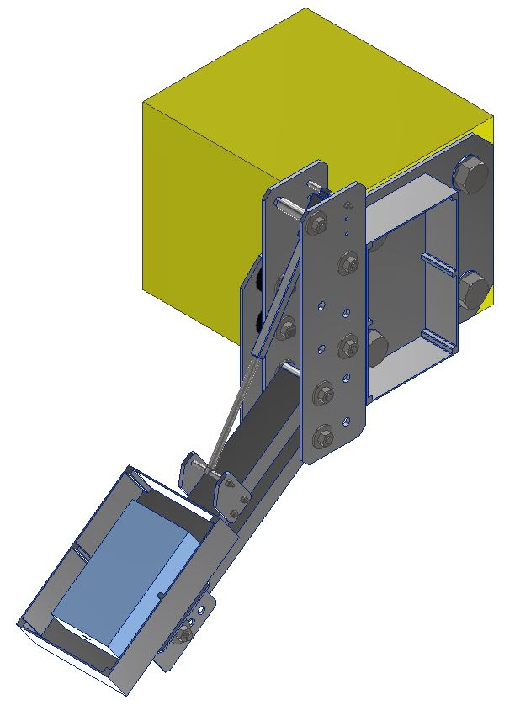
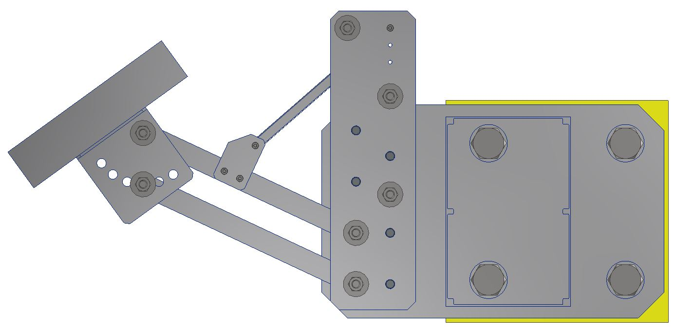
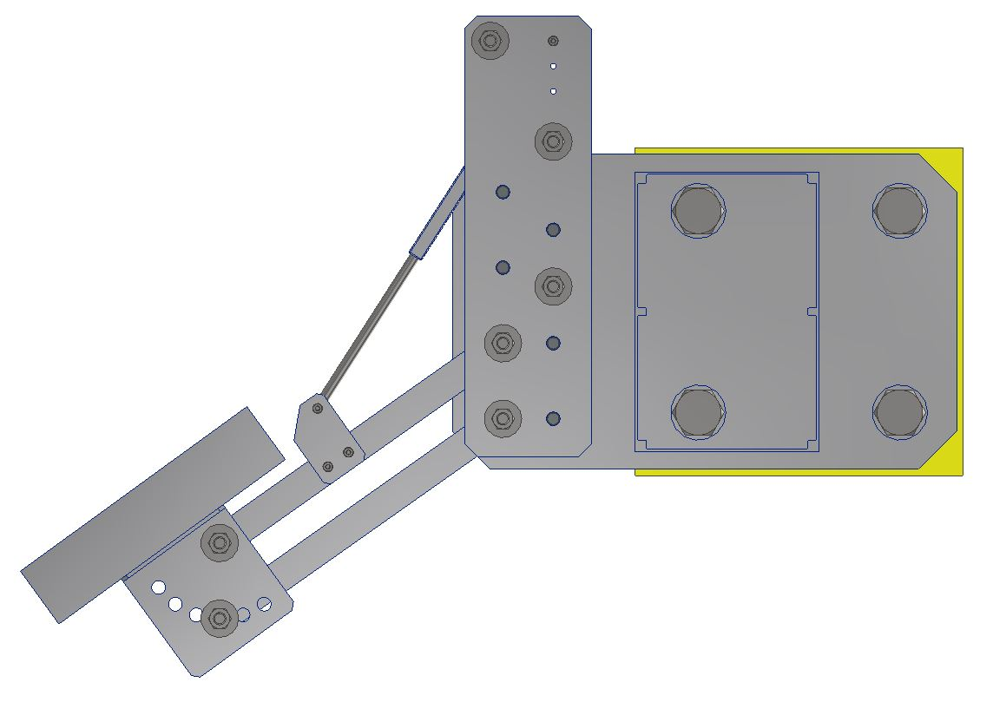
130mm

Slide 5
130mm
~500mm
~700mm

Slide 6
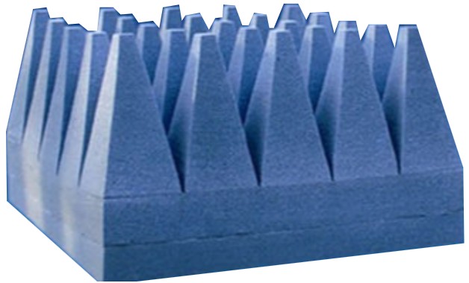
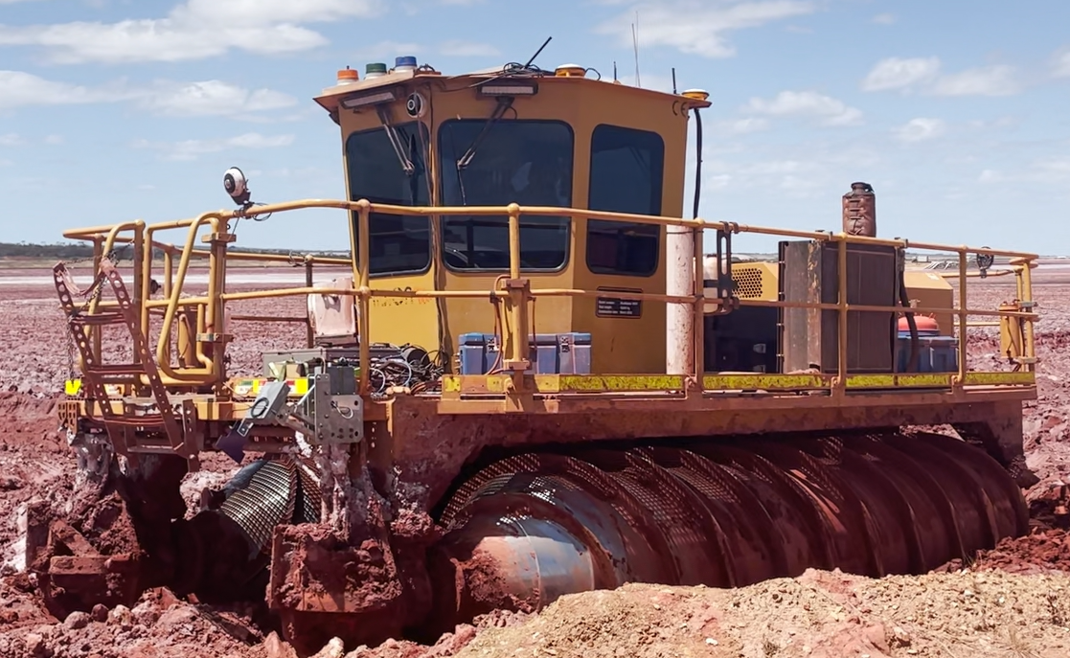
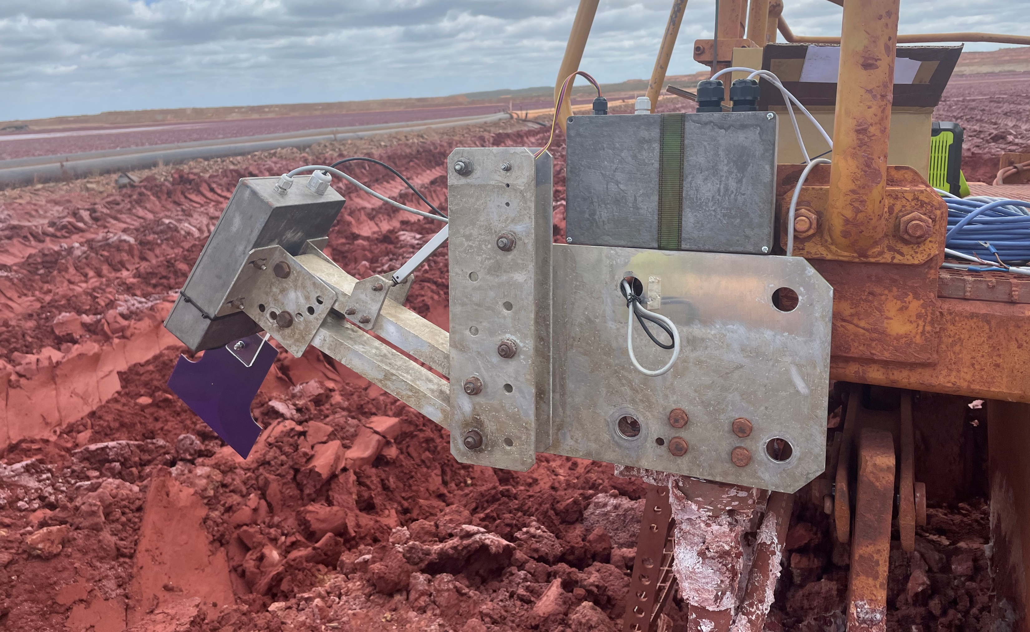
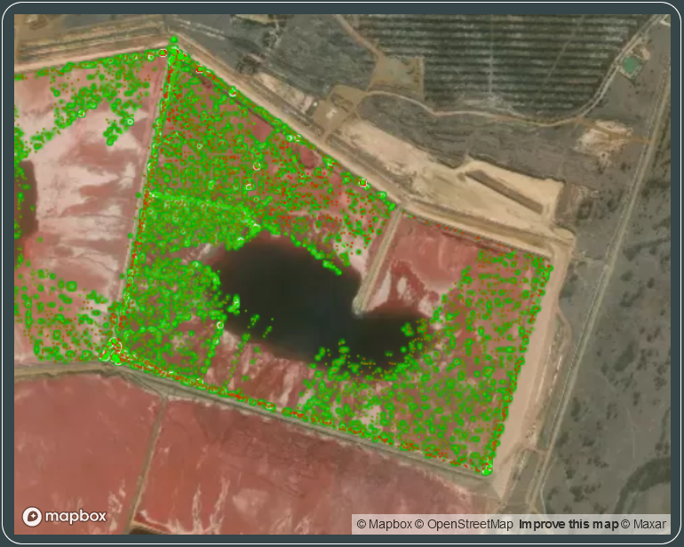
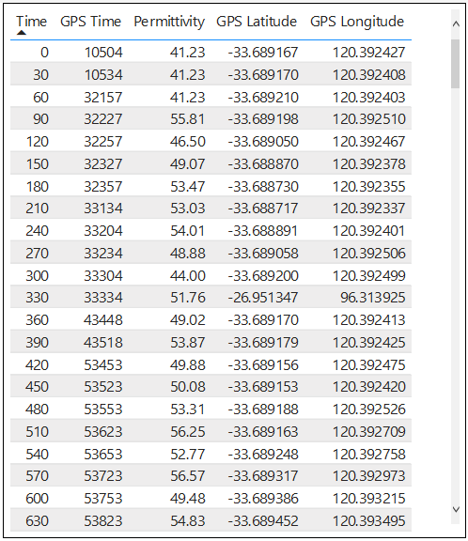
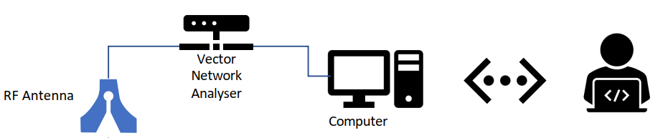

Linux Computer (Arduino)
The Dielectric Antenna is a composite system (figure 1) made up of the following physical components (figure 1):
Vivaldi Antenna – Operating at a frequency of 0.6 GHz to 1 GHz;
Vector Network Analyser (VNA) – Used to send and receive signal to and from the Antenna. Multiple ports will increase accuracy of reading;
Windows Computer (not displayed in figure) – Runs the VNA controller software suite (both Megiq and Python) and collects the log files over USB connectivity;
Linux Computer (Arduino) – hosts the Calibration and Operation interface for the VNA and Antenna and controls the mechanical actuator;
Mechanical Actuator – is used to calibrate the VNA / Antenna at various heights
When mounted to the MudMaster (figure 3) and powered, the Dielectric Antenna will send a radio wave at a pre-set interval toward the tailings and then measure the reflection of that wave and log the permittivity of the material at that given moment.
Prior to logging, a sample is required to characterise the calibration of the system. This provides a conversion from permittivity (as logged by the system) to density and porosity.
Along with the GPS coordinates, the permittivity is logged and stored on the Windows Computer.
This data is later transposed to a data analytic report in the form of a heat map (figure 4)
The result is a display of the average permittivity, density and water saturation of the tailings in a given location.
Mechanical Actuator
Vector Network Analyser
Vivaldi Antenna
FIGURE 2.3
FIGURE 2.1
FIGURE 2.2
FIGURE 3.1
FIGURE 3.2
FIGURE 1
FIGURE 4

Slide 7
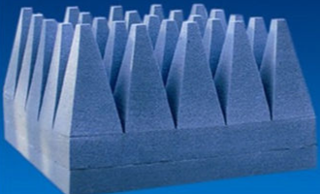
Please provide a detailed written description of how your invention is constructed or implemented, including drawings or sketches (if applicable).
The Dielectric Antenna is a composite system (figure 1.0) made up of the following physical components:
Vivaldi Antenna – Operating at a frequency of 0.6 GHz to 1 GHz;
Vector Network Analyser (VNA) – Used to send and receive signal to and from the Antenna. Multiple ports will increase accuracy of reading;
Windows Computer – Runs the VNA controller software suite (both Megiq and Python) and collects the log files over USB connectivity;
Linux Computer (Arduino) – hosts the Calibration and Operation interface for the VNA and Antenna and controls the calibration actuator.
When mounted to the MudMaster (figure 2.0) and powered, the Dielectric Antenna will send a radio wave at a pre-set interval toward the tailings and then measure the reflection of that wave and log the permittivity of the material at that given moment.
Prior to logging, a sample is required to characterise the calibration of the system. This provides a conversion from permittivity (as logged by the system) to density and porosity.
Along with the GPS coordinates, the permittivity is logged and stored on the Windows Computer.
This data is later transposed to a data analytic report in the form of a heat map (figure 3.0)
The result is a display of the average permittivity, density and water saturation of the tailings in a given location.
David Frazer…. (picture of what it looks like and where it will be mounted plus a rough engineering description of how it works.
[This description should be sufficient for a person of ordinary skill in the relevant field to put the invention into effect. Drawings should be included where applicable, but detailed engineering drawings are not required. If the invention is an apparatus, describe its construction and operation. If the invention is a composition, describe both its components and uses. If the invention is a method, describe the steps in the method. Actual examples or trials of the method should also be described, if available. Features which are already known need not be described in detail. However, you should clearly describe the features of your invention which you consider to be novel].

